Slide 1




VOICE
Emerging Virtual Assistant

Slide 2


Our Team
GUIDED BY
Ms.S.Murugavalli., M.E,AP/AI
TEAM MEMBERS:
ABDUR RAZIQ FAREED.R – 811721243002
ABILASH.K – 811721243003
ISHAN SANJEEV.R – 811721243018
MOHAMMED ARSHATH ROSHAN.M - 811721243032

Slide 3
OBJECTIVE
Enhance user interaction with voice-activated virtual assistant.
Provide seamless voice recognition and speech synthesis.
Offer real-time responses to voice commands.
Ensure compatibility across devices and operating systems.

Slide 4
EXISTING SYSTEM
Users often face challenges in navigating tasks efficiently and accessing information quickly.
Traditional interfaces may lack intuitive features, leading to a fragmented user experience.
Moreover, manual execution of tasks consumes time and effort.
There's a need for a more streamlined approach to assist users in their daily activities, enhancing productivity and convenience.

Slide 5
PROPOSED SYSTEM
The virtual assistant, named "Voice," is designed to assist users with various tasks through voice commands.
It is equipped with speech recognition capabilities to understand user input and provide relevant responses or actions.
The system aims to provide a seamless and intuitive user experience, offering assistance across different domains such as information retrieval, task automation, and web browsing.

Slide 6
LITERATURE SURVEY
S.NO | PAPER TITLE | AUTHOR NAME | YEAR PUBLISHED | TECHNIQUE USED | MERITS | DEMERITS
1. | Enhancing Voice-Controlled Python Assistant | IEEE FEB 2021 | Nivedita Singh (2021) | Integration of API Calls using requests Library Context-Aware Response Mechanism using contextlib and sqlite3 | Efficiency, accuracy,data analysis | Dependency on Internet Connectivity,
2. | Voice-Driven PC Control | IEEE aug-2021 | V. Geetha | Addressing Delay in Request Processing speech_recognition for speech-to-text. asyncio for implementing asynchronous processing. | Enhanced User Experience, Quick Information Retrieval | Low fault tolerance, inaccuracy, dependency.

Slide 7
LITERATURE SURVEY
S.NO | PAPER TITLE | AUTHOR NAME | YEAR PUBLISHED | TECHNIQUE USED | MERITS | DEMERITS
3. | Integrating AI and IoT in Python | IEEE Nov 2022 | Abeed Sayyed | Predictive Maintenance using Machine Learning in IoT with Scikit-Learn Libraries:Scikit-Learn for machine learning. paho-mqtt for MQTT communication. | Real-Time Decision-Making, scalability | Initial Setup Costs, Maintenance and Updates
4. | A Python-Powered Voice Assistant Reducing Hardware Dependency" | IJERT Aug 2020 | Abidi Paul | Context-Aware Command Execution with subprocess Library | Efficiency in Command Execution | Limited Hardware Control.

Slide 8
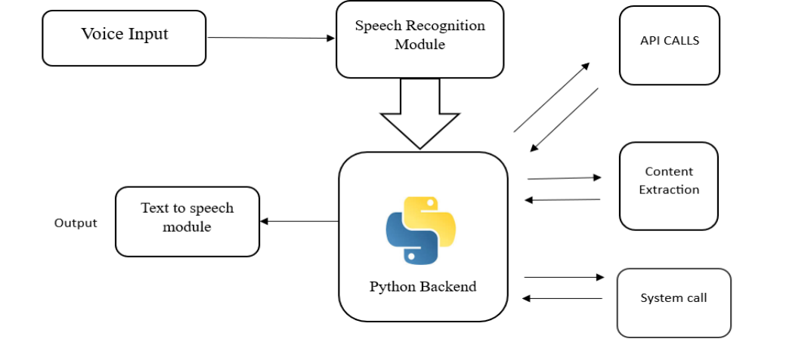
ARCHITECTURE DIAGRAM

Slide 9
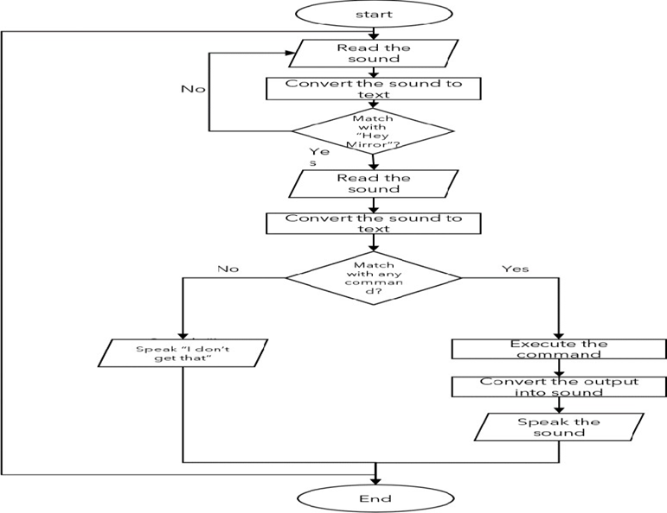
DATA FLOW DIAGRAM

Slide 10
SYSTEM REQUIREMENTS
HARDWARE:
Processor: Dual-Core or higher
Memory (RAM): 2 GB minimum, 4 GB recommended
Storage: 100 MB free disk space minimum, 500 MB recommended
Microphone: Required for speech recognition
Speakers or Headphones: Required for text-to-speech
Software:
Operating System:
1) Windows 7 or later
2) macOS 10.12 or later
3) Linux (any modern distribution)
Web Browser: Latest versions of Chrome, Firefox, Edge, or Safari

Slide 11
SYSTEM REQUIREMENTS
Dependencies:
Node.js (Optional for development): Version 12.x or later
Code Editor (Optional for development): Visual Studio Code, Sublime Text, Atom, or any text editor of choice
JavaScript Libraries: Font Awesome, Google Fonts
APIs: Web Speech API for speech recognition and text-to-speech
Additional Requirements:
Internet Connection: Required for accessing external resources
Development Tools: Optional tools like Git and npm
Permissions: Microphone access for speech recognition

Slide 12
MODULES
HTML Modules
CSS Modules
JAVA SCRIPT Modules

Slide 13

HTML MODULE
HTML Structure and Head Section
1. <!DOCTYPE html>:
Declares the document type and version of HTML being used.
Ensures the document is rendered in standards mode.
2. <html>:
The root element of an HTML document.
Encloses all other HTML elements.
3. <head>:
<meta charset="UTF-8">: Specifies the character encoding.
<meta name="viewport" content="width=device-width, initial-scale=1.0">: Ensures the webpage is responsive.
<title>Document Title</title>: Sets the title of the webpage.
<link rel="stylesheet" href="styles.css">: Links to external CSS.
<script src="script.js"></script>: Links to external JavaScript.

Slide 14
HTML MODULE
BODY SECTION
1. <body>:
Contains the visible content of the HTML document.
Key elements:
1) <header>: Defines the header section.
2) <nav>: Defines navigation links.
3) <main>: Main content area.
4) <section>: Defines sections within the main content.
5) <article>: Represents self-contained content.
6) <footer>: Defines the footer section.

Slide 15
CSS MODULE
EXTERNAL AND INTERNAL CSS
External CSS:
Linked using the <link> tag in the <head> section.
Examples:
1) Google Fonts: fonts.googleapis.com/css2?family=Roboto+Mono:wght@100;200;300;400
2) Font Awesome: cdnjs.cloudflare.com/ajax/libs/font-awesome/5.15.3/css/all.min.css
Internal CSS:
Defined within the <style> tag in the <head> section.
<style>
body {
font-family: 'Roboto Mono', monospace;
margin: 0;
padding: 0;
}
h1 {
color: #333;
}
</style>

Slide 16
CSS MODULE
CSS CONCEPTS AND BOX MODEL
Selectors:
Select HTML elements to apply styles.
Types: element selectors, class selectors, ID selectors, and attribute selectors.
2. Properties and Values:
p {
color: blue;
font-size: 14px;
}
3. Box Model:
box {
margin: 10px;
padding: 20px;
border: 1px solid black;
}

Slide 17
JAVASCRIPT MODULE
SPEECH RECOGNITION AND TEXT-TO-SPEECH
1. Speech Recognition:
Initializes the SpeechRecognition object.
Starts recognition on button click.
Handles speech recognition results.
const SpeechRecognition = window.SpeechRecognition || window.webkitSpeechRecognition;
const recognition = new SpeechRecognition();
Text-to-Speech:
Uses the SpeechSynthesisUtterance object.
Speaks the given sentence.
const text_speak = new SpeechSynthesisUtterance(sentence);
window.speechSynthesis.speak(text_speak);

Slide 18
JAVASCRIPT MODULE
EVENT HANDLING AND CUSTOM RESPONSES
Event Handling:
Adds event listeners for window load and button click.
Executes functions on these events.
window.addEventListener('load', () => { ... });
btn.addEventListener('click', () => { recognition.start(); });
recognition.onresult = (event) => { ... };
2. Custom Responses:
Processes recognized speech to provide appropriate responses.
Uses conditional checks to determine the response.
function speakThis(message) {
const speech = new SpeechSynthesisUtterance();

Slide 19
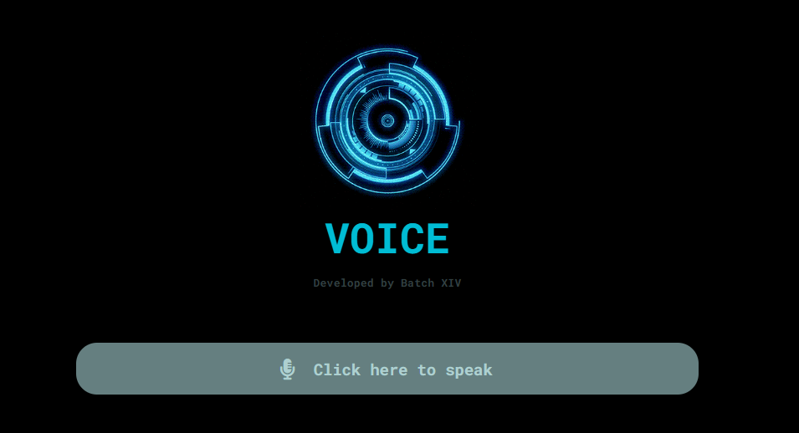
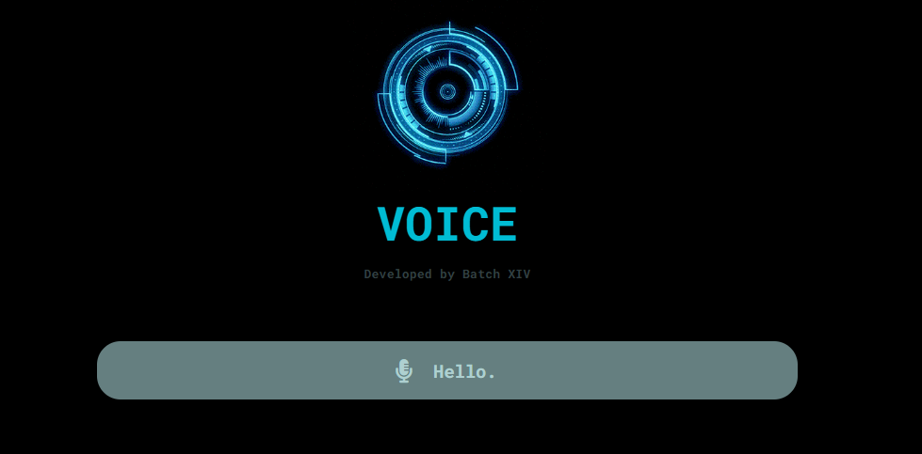
HOME PAGE
When the user opens our application our home page will appear like this and the voice button is used to get voice input.
When the user says “HELLO” the application will reply and shows what you have said in the text allowance box.

Slide 20
ADVANTAGES
Universal accessibility
Personalized assistance
Intuitive interface
Streamlined efficiency
Unified productivity

Slide 21
APPLICATIONS
Education and Learning
Personal Finance Management
Smart Home Control
Information Retrieval
Task Automation

Slide 22
CONCLUSION
In conclusion, Voice emerges as a multifaceted virtual assistant, proficient in understanding and executing user commands swiftly and accurately.
With its intuitive interface and robust feature set, it streamlines interactions, fostering enhanced productivity and efficiency.
Users can entrust Voice with a wide array of tasks, confident in its ability to deliver reliable and seamless assistance across various domains.

Slide 23
REFERENCES:
1) Books:
Natural Language Processing with Python" by Steven Bird, Ewan Klein, and Edward Loper.
Building Chatbots with Python: Using Natural Language Processing and Machine Learning" by Sumit Raj.
2) Research Papers:
Dialog State Tracking: A Machine Learning Approach" by Jason D. Williams and Steve Young
Recent Advances in Deep Learning for Speech Research at Microsoft" by Geoffrey Zweig et al
3) Documentation and APIs:
Natural Language Understanding APIs (e.g., Google Cloud Natural Language API, IBM Watson NLU)
4) Academic Journals:
IEEE Transactions on Audio, Speech, and Language Processing
ACM Transactions on Speech and Language Processing

Slide 24
THANK YOU
VOICE

